Slide 1
CMSC201
Computer Science I for Majors
Lecture 25 – Final Exam Review
Prof. Katherine Gibson

Slide 2
Exam Rules
The final is closed everything:
  No books
  No notes
  No cheat sheets
  No laptops
  No calculators
  No phones

Slide 3
Exam Rules
Place your bookbag under your desk/chair
  NOT on the seat next to you
You may have on your desk:
  Pens, pencils, erasers
  Water bottle
  UMBC ID

Slide 4
Exam Rules
DO NOT CHEAT!!!
Cheating will be dealt with severely and immediately
  If a TA or instructor sees you looking at another student’s paper (or anything other than your own exam) they will take your test from you

Slide 5
Exam Time
Final Exam will held be on Friday,
December 11th from 3:30 to 5:30 PM
If you need SSS accommodations, you must request them and notify us ASAP
If you will be unable to take the exam at that time, you must notify your instructor ASAP

Slide 6
Exam Locations
Being held in three separate rooms
    Section 1 (Gibson, MW @ 1) – CHEM 030
    Section 7 (Dixon, TR @ 5:30) – CHEM 030
    Section 13 (Dixon, TR @ 10) – CHEM 030
    Section 19 (Morawski, MW @ 4) – PAHB 132
    Section 25 (Gibson, TR @ 4) – PHYS 101
Make sure you go to the correct room!

Slide 7
Exam Seating
Space allowing, you will sit every other seat, so that you are not next to another student
Your instructor may have specific instructions for their lecture hall seating arrangements
Make sure you know how to get to your exam room location – arrive early if possible!

Slide 8
Questions about Exam Rules?

Slide 9
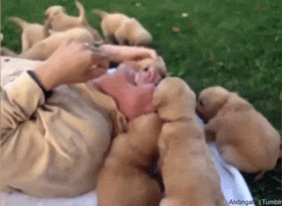

Slide 10
Exam Format
Similar to the midterm
  Going over the slides and making sure you are comfortable with the material would be a good idea
  Try some of the exercises and practice examples available in the slides

Slide 11
Exam Format
Multiple Choice
True/False
Code evaluation
  Given code, what does it do?
Debugging
  Find and fix errors
Fill in the blank
  Complete a piece of partially-written code

Slide 12
Questions about Exam Format?

Slide 13
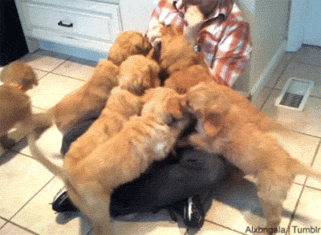

Slide 14
Exam Content
Everything we covered at the beginning!
From the midterm, you should be familiar with:
  Evaluating expressions
  Control structures
    For Loops
    While Loops (including Interactive loops)
    If/Elif/Else
  Decimal <-> Binary conversion

Slide 15
Exam Content
From the midterm, you should be familiar with:
  Lists
    Indexing (including Negative indexing)
    Appending
  Debugging
  Strings
    String functions like split()

Slide 16
Exam Content
Everything else we’ve covered so far!
You should be especially familiar with:
  More control structures
    Recursion
    Functions
      Passing and returning variables
  File I/O

Slide 17
Exam Content
You should be especially familiar with:
  Data structures
    Tuples
    Dictionaries
  Classes
    Creating a class
    Data vs class attributes
    Constructors
    Built-in methods

Slide 18
Exam Content
You should be especially familiar with:
  Algorithms and Analysis
    Searching algorithms
      Linear
      Binary
    Sorting algorithms
      Selection
      Bubble
      Quick

Slide 19
Exam Content
You should be especially familiar with:
  Recursion
    Recursion
      Recursion
  Program design
    Top down design
    Creating “good” code

Slide 20
Questions about Exam Content?

Slide 21
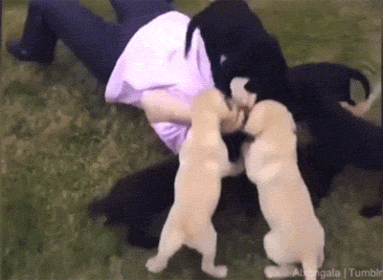

Slide 22
Exam Advice
Write down your name and circle your section
Flip through the exam and get a feel for the length of it and the types of questions

Slide 23
Exam Advice
Most questions have partial credit
  You should at least attempt every problem
  If you don’t know how to do one part of the problem, skip it and do the rest
  Make sure to pace yourself – this exam is longer than the midterm!

Slide 24
Exam Advice
If a problem is unclear or you think there is an error on the exam, raise your hand

Slide 25
Any Other Questions?

Slide 26
Announcements
Project 2 is out
  Due by Tuesday, December 8th at 8:59:59 PM
  Do NOT procrastinate!
Final is on Friday – Dec 11th, 3:30 – 5:30 PM
  You must bring your UMBC ID with you to the exam! We won’t accept your test without it.
  You can do it! We believe in you!

Slide 27
Review Time!
What would you like to cover?

Slide 28
